Slide 1
College Swap
Justin Kerber
Patrick Boatner
Charodd Richardson
Christopher Popovich

Slide 2
Updated Problem Definition
Students trade textbooks and tickets
Facebook available but suboptimal
Solution?
Design problem-specific app
User-friendly

Slide 3
Updated Scope of System
Cannot view full profile of other users
No text search
Choose category
Filter by fields relevant to category

Slide 4
Note about Notation
Activities not allowed to create activities
Create Intent, pass it ViewModel
We denote this process as ‘new X’
Represent
"new Intent(); intent.addExtra(e); startActivity()"
as "new activity(e);"

Slide 5
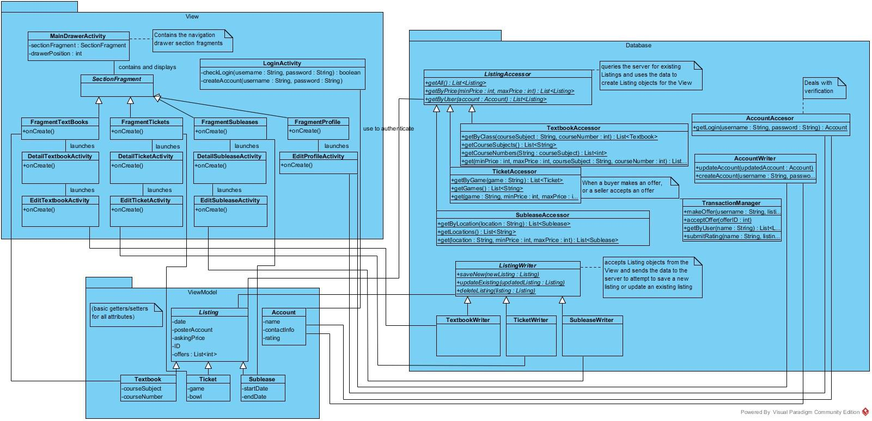
Detailed Class Diagram

Slide 6
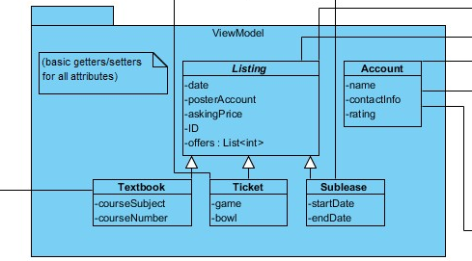
Detailed Class Diagram - ViewModel
Only added relationship lines

Slide 7
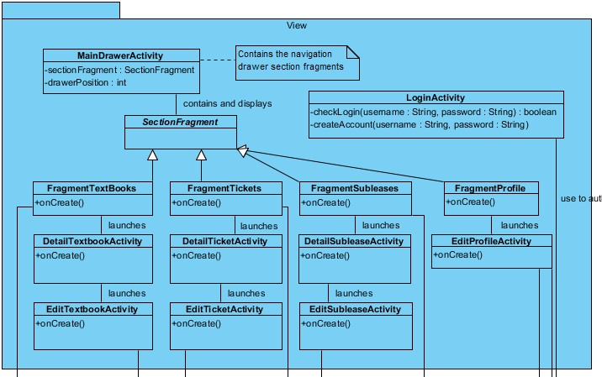
Detailed Class Diagram - View
Section Fragment to show profile
transactions
Activity to edit profile

Slide 8
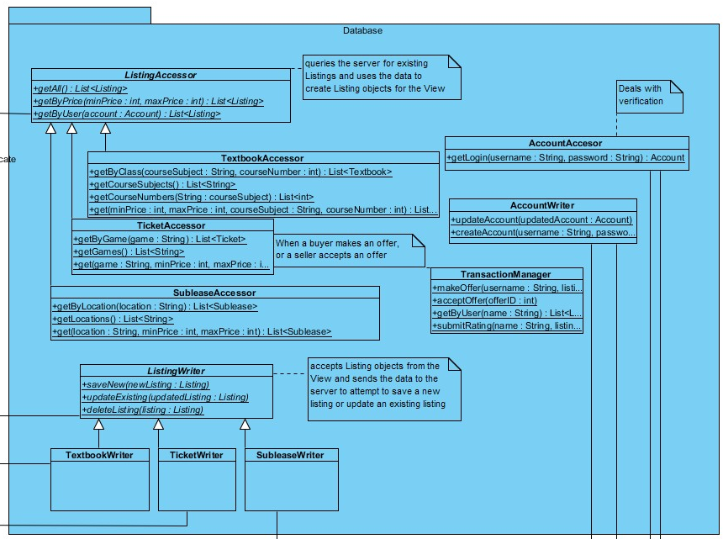
Detailed Class Diagram - Database
ListingAccessor
getByUser()
for user’s profile
Subclasses- methods for price range and criteria
Changed to static methods

Slide 9
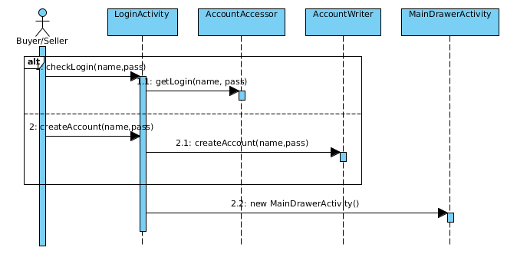
Sequence Diagrams
Log in, Create account

Slide 10
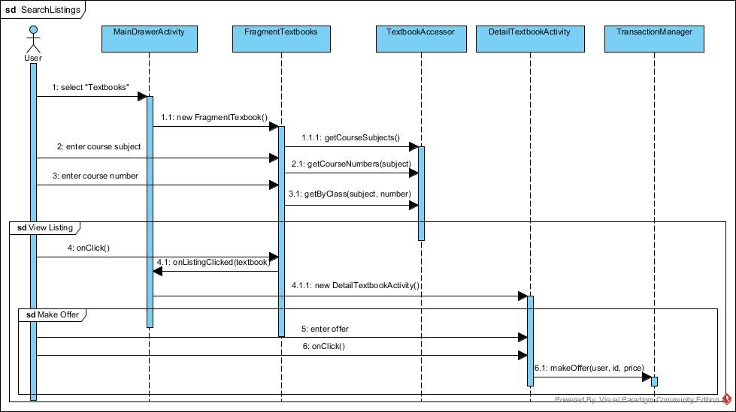
Sequence Diagrams
Search for listings, view listing, and make offer (cont.)

Slide 11
Sequence Diagrams
Search for listings
choose category in drawer, enter criteria
note getCourseSubjects() and getCourseNumbers() - huge benefit of College Swap
View individual listing
FragmentTextbooks lets MainDrawerActivity launch detailed Activity
Make offer
TransactionManager

Slide 12
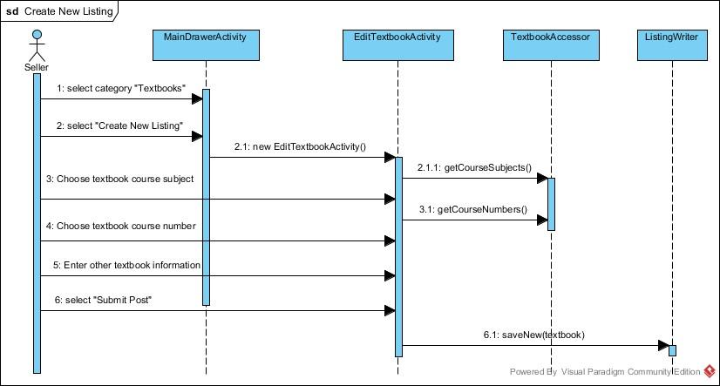
Sequence Diagrams
Create new listing
EditTextbookActivity- input fields for textbook
ListingWriter
Note getCourseSubjects() and getCourseNumbers(), like searching for listings

Slide 13
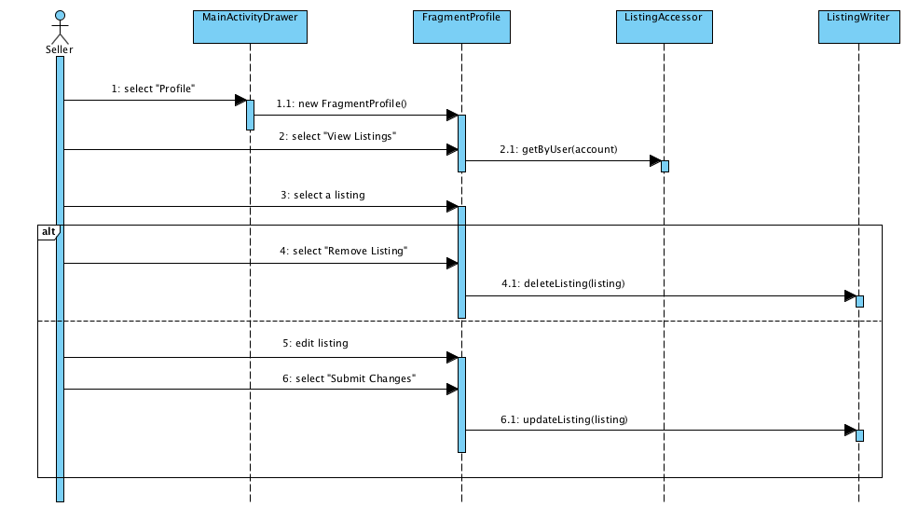
Sequence Diagrams
Update Listing - edit/remove listing

Slide 14
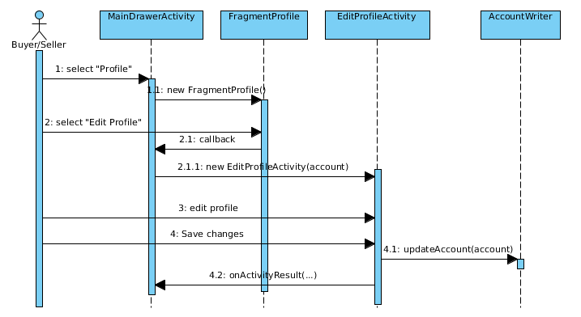
Sequence Diagrams
View Profile- displays user’s profile
FragmentProfile
Edit Profile
input fields
AccountWriter

Slide 15
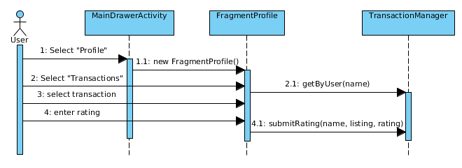
Sequence Diagrams
Submit User Rating
User views their profile, opens Transaction history

Slide 16
Priority Focus Changes
Email preferred over push notifications
making offers
accept offers

Slide 17
Summary
Established more understanding of Sequence Diagrams and their uses
Android app + Server = ambitious
cut down on server side transaction logic

